Slide 1

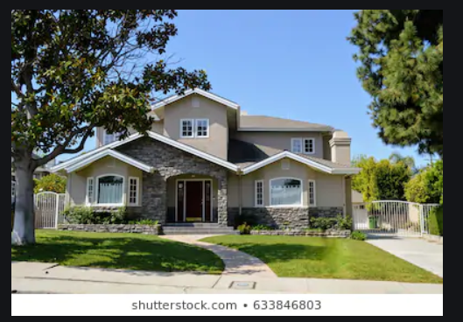
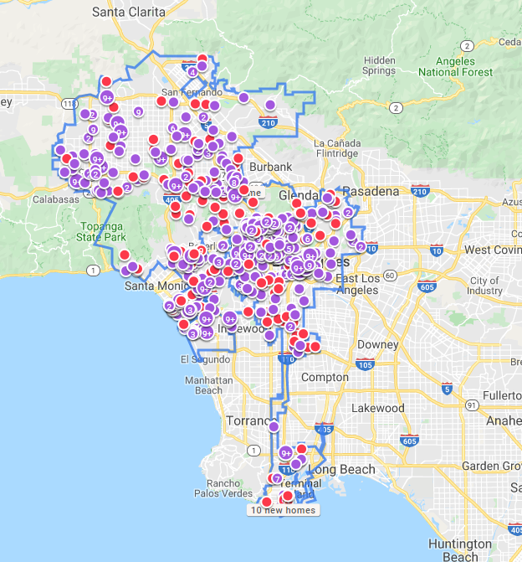
LA house Value
Elly Kyles

Slide 2


Motivation & Project Description
I am a big fan of Fixer Upper, flip flop TV show and always interested in home values
This project is all about understanding LA house values and comparing them with other cities’

Slide 3
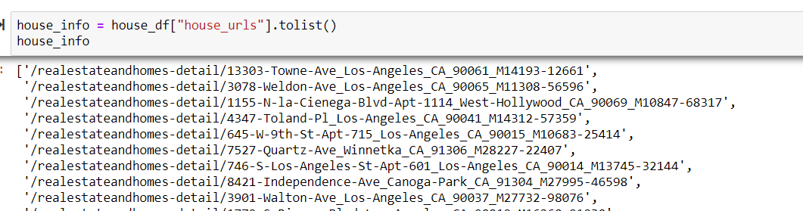
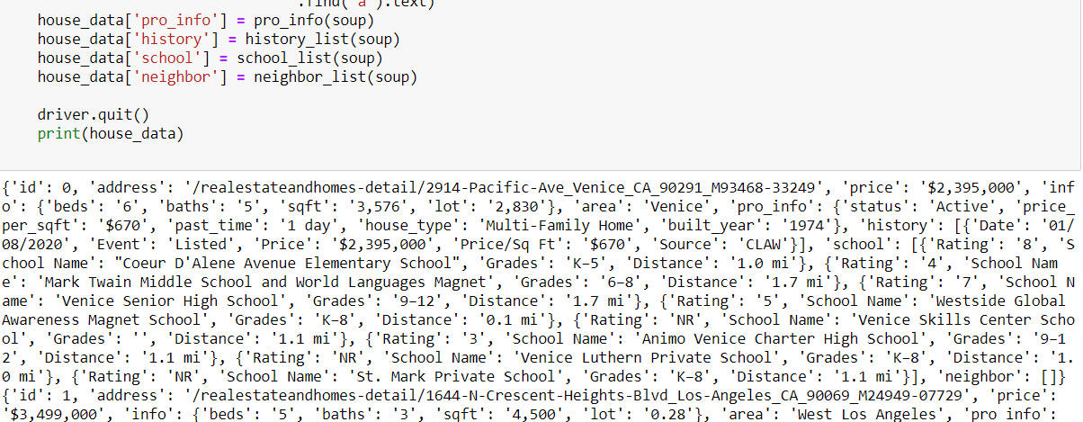
Web Scarping
As my first attempt is to get realtor.com data by doing web scraping, I was able to collect 7613 of house’s URL listed in realtor.com
After collecting the URLs and requesting the houses information from Realtor.com 10 times, unfortunately, the realtor.com website blocked me.
The reason was that the website recognized that requesting the data with using the same IP address is webscraping so they blocked me
One lesson that I learned from web scraping, I have to change my IP address or user-agent for each request.

Slide 4
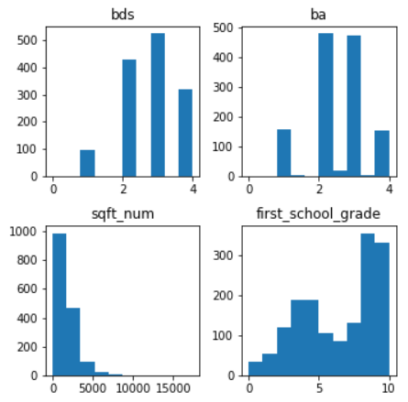
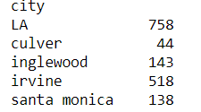
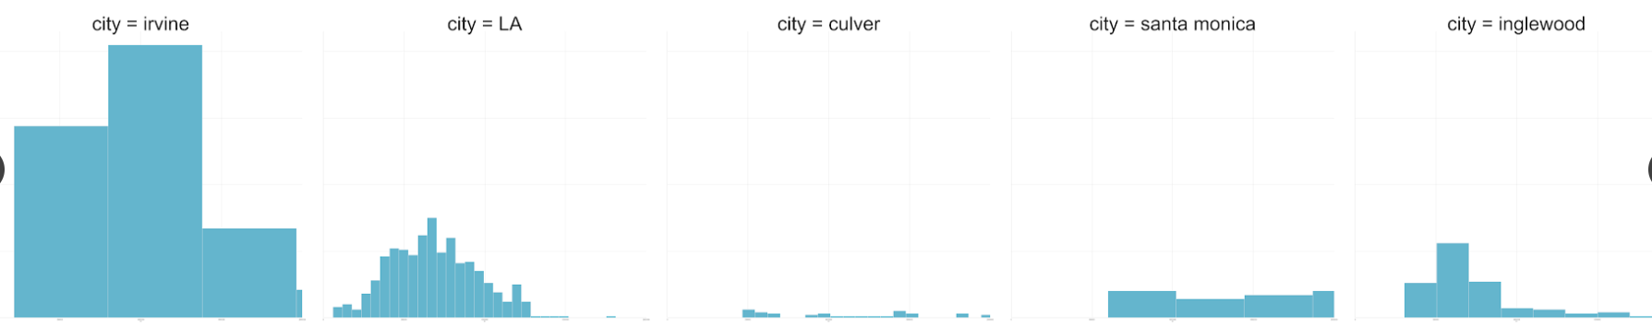
About Zillow Data
Collected Zillow Data from webscraping tool.
Areas: Los Angeles, Culver City, Inglewood, Irvine, Santa Monica
1969 data, 19 features
features: address, price, beds, baths, sqft, views, saves, type, history of price, school, Zillow prediction and so on.

Slide 5
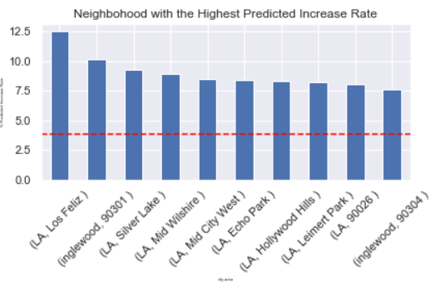
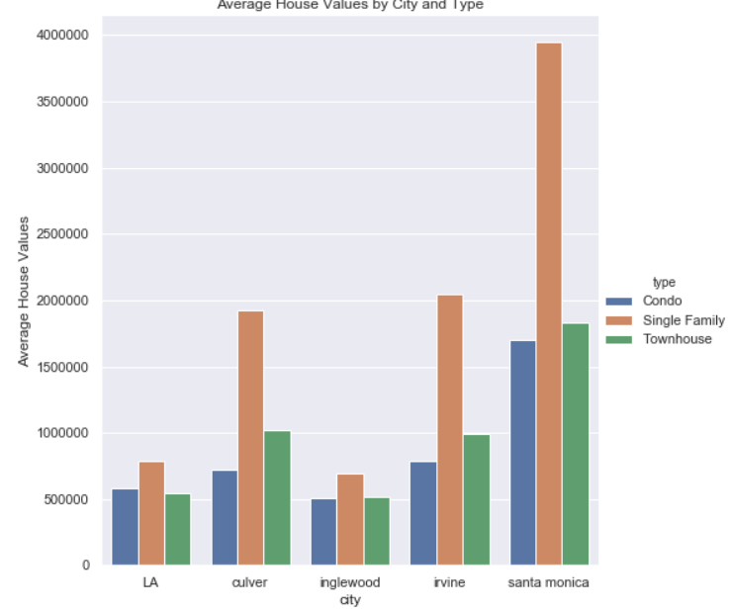
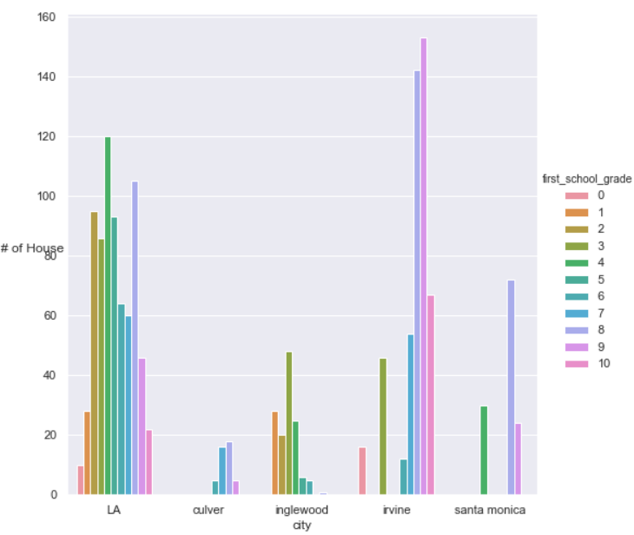

Slide 6
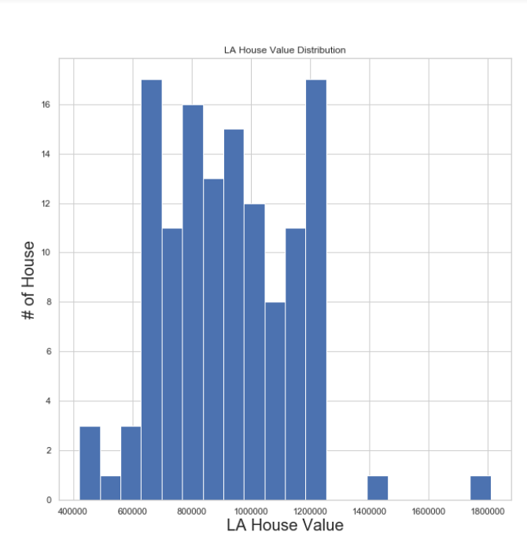
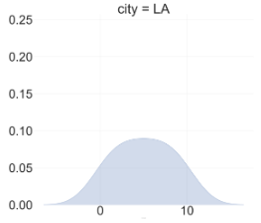
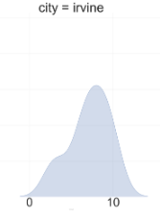
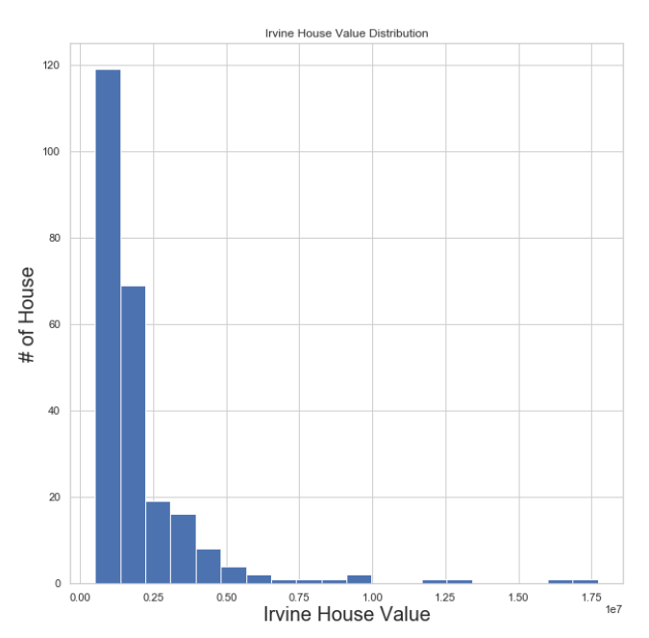
Hypothesis Test
My understanding of the previous slide showing that LA’s single-family houses are signifincantly lower than Irvine’s is because Irvine has a lot of great school district than LA (LA’s school district is more normally distributed – Irvine’s is right skewed)
Null Hypothesis: No difference in average house value between LA and Irvine after selecting data that has first school rating is greater than 7. (LA data: 129, Irvine data: 246)
Alternative Hypothesis: They are difference
Significant Level: 20%
Non-Parametrics:Mann-Whitney Signed Rank Test
Number of LA wins : 4979
Number of Irvine wins: 26755
Using stats.mannwhitneyu(Irvine, LA, alternative =‘greater’)
P-value for Irvine<LA is almost 0
My null hypothesis should be rejected

